Slide 1


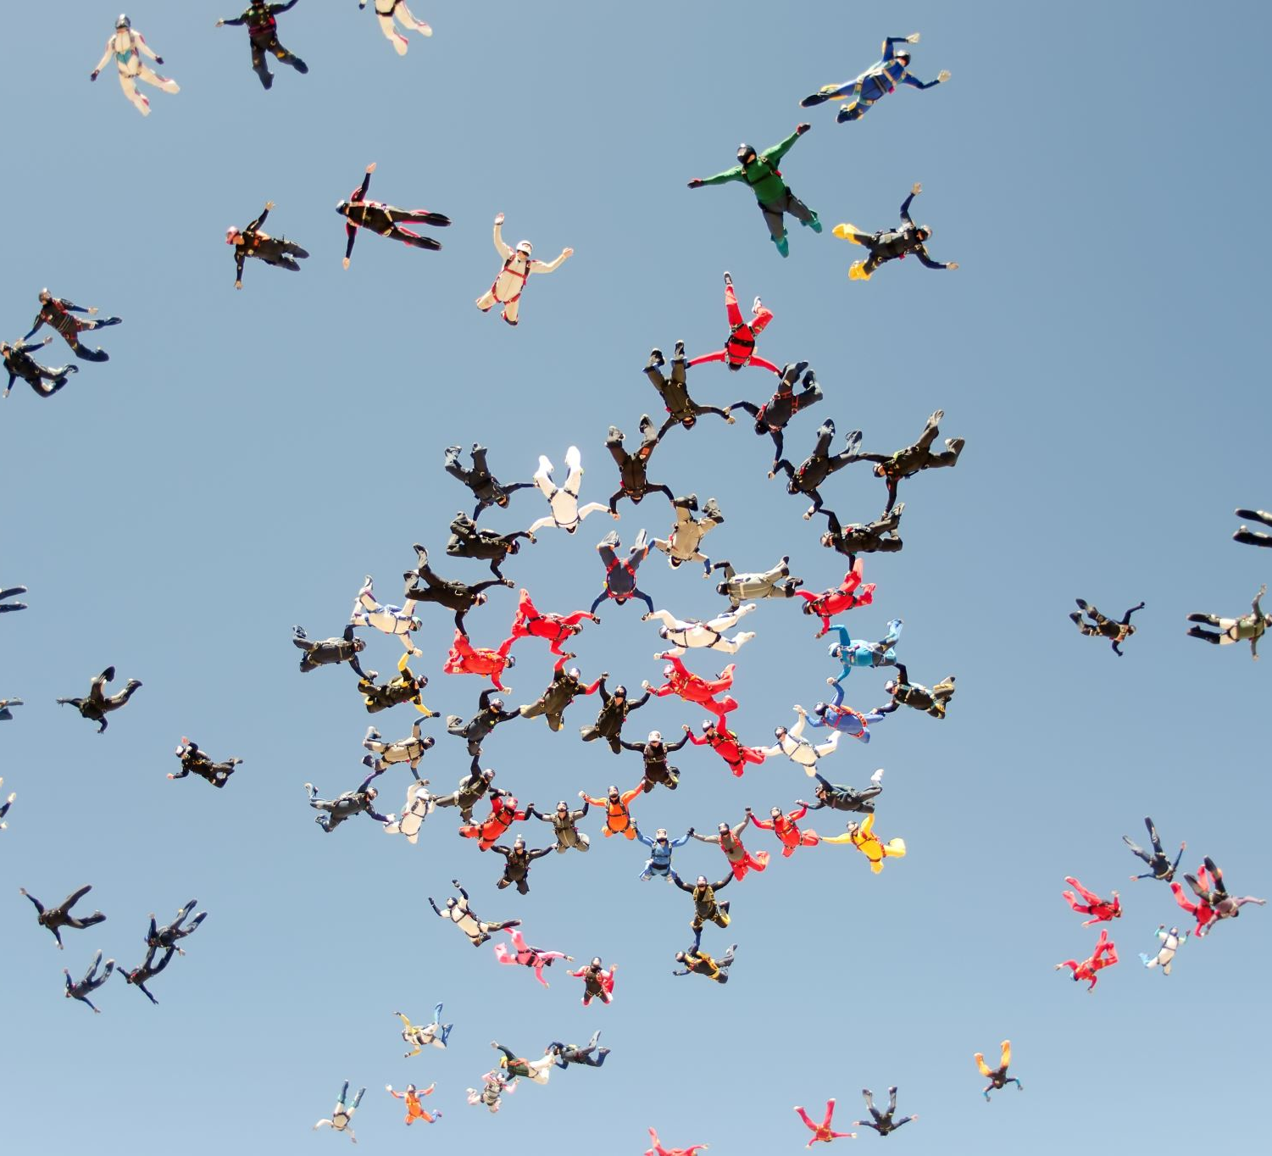
BDAT1004 - Final Presentation GROUP - 8
By
MURARI MADIVADA
MUKUND SAI MADHAV MURUGULLA
SAI MEGHANA GOTTIPATI

Slide 2
Project SUMMARY
Providing Information about superstore sales and analyzing the profit according to the states in United States and is a large dataset.
From this data set we have done a web application where the visualizations of the dataset can be accessed, and it is clear to understand without even reviewing the dataset.
We have used different software to build this web application with desired visuals.

Slide 3
Project STEPS
The following are the major steps for this project:
Finding the relevant dataset that is superstore data
The next step after finding the data is creating an SQL database where we can connect that data to it. We need to use software like flask for backend.
By using the data we will be generating the graphics or visuals to it.

Slide 4
Find Reliable Data
https://community.tableau.com/docs/DOC-1236
Firstly, to start the project we need a good dataset where the data is easily accessible to the customers and is easy to understand. So we have selected this large dataset where the visualizations can be clear.
The above link is reference to our dataset.

Slide 5
our team and skills
Murari Madivada (Developer / Data Analyst) - develop the software front and back end, we collectively worked on the front and back-end software as we are from same background
Project Manager ( SAI MEGHANA GOTTIPATI) - manage the deliverable of the project, works with Business Analyst to build the documentation for proposal
1 Business Analyst Mukund Madhav ( Business Analyst) - build documentation for proposal

Slide 6
Creating SQL DATABASE
Navigate the SQL LITE creation process
SQL lite was ultimately very user friendly
We can access the data as we don’t need to install SQL
- default installed

Slide 7
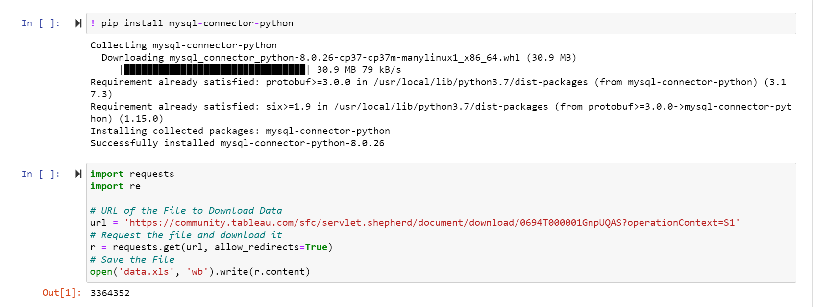
CREATE SQL DATABASE

Slide 8
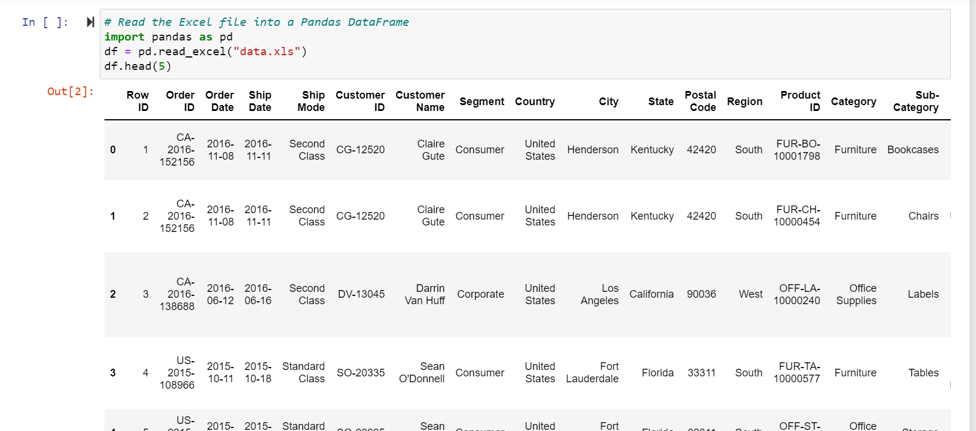

Slide 9
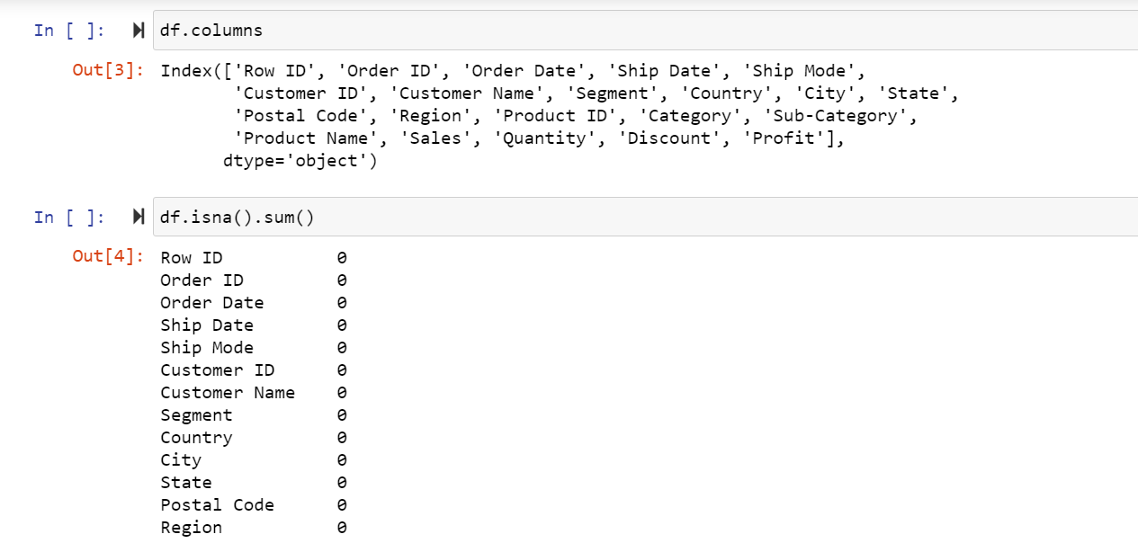

Slide 10
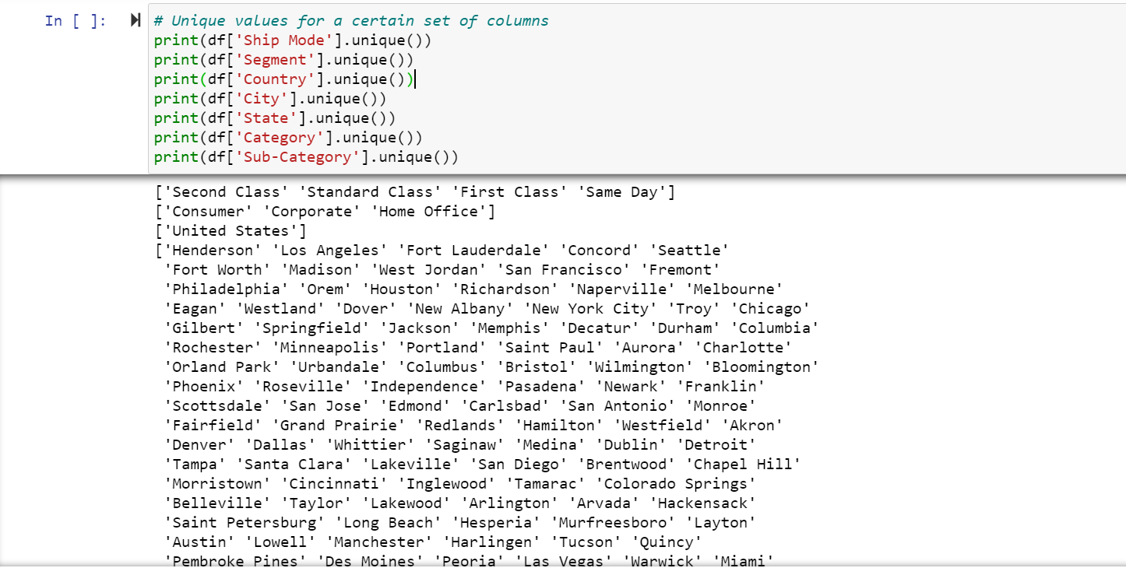

Slide 11
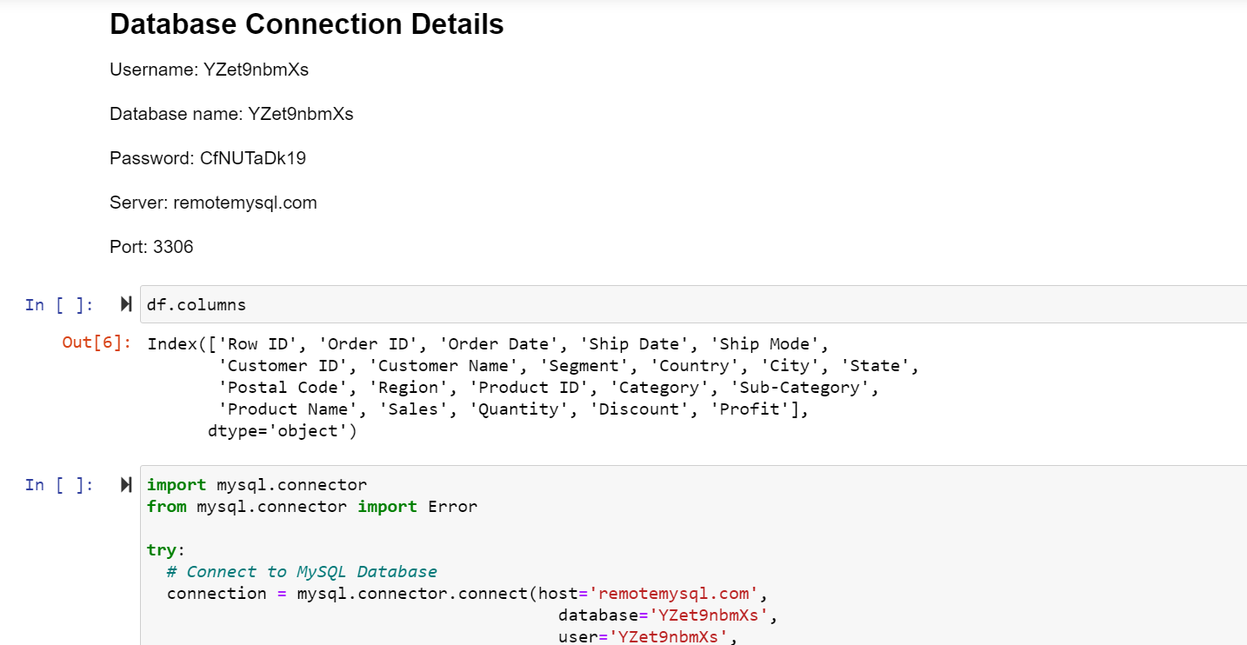

Slide 12
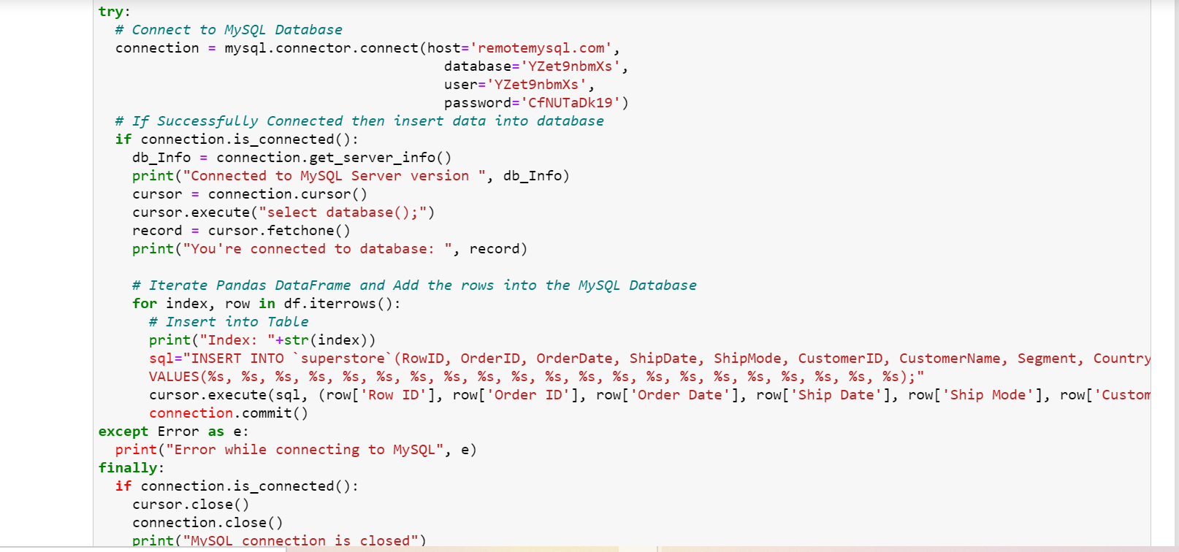

Slide 13
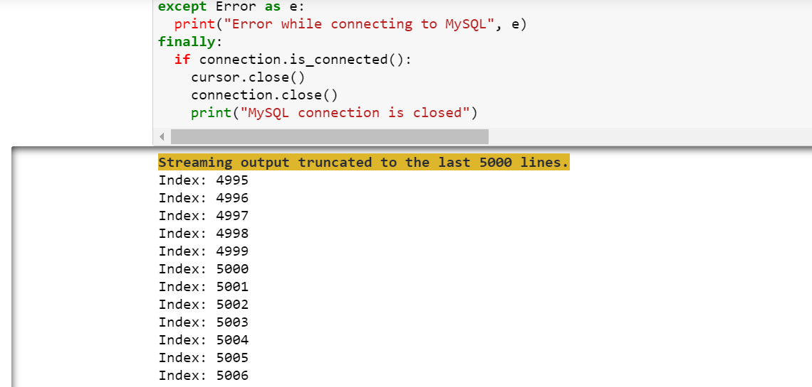

Slide 14
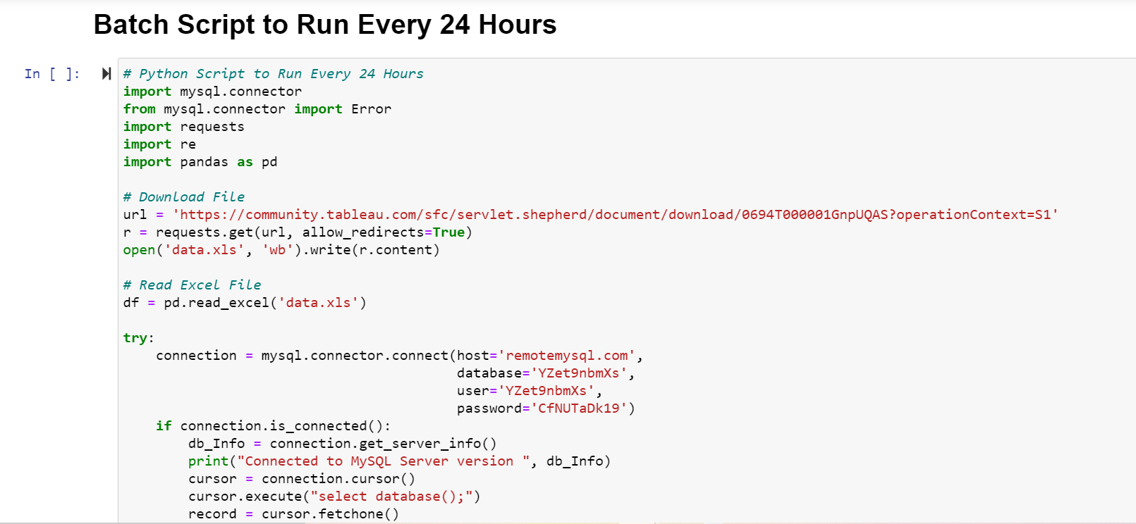

Slide 15
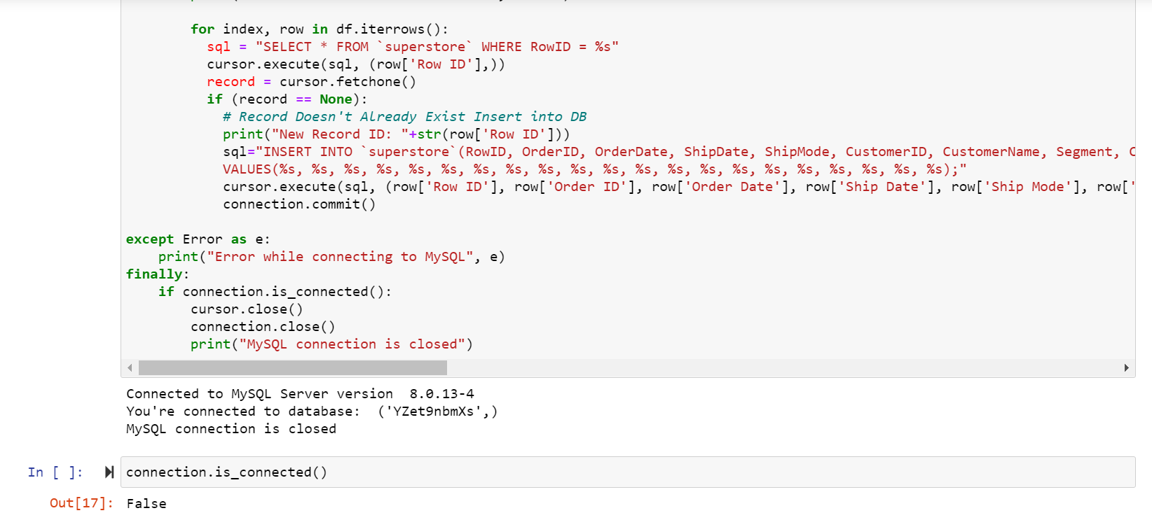

Slide 16
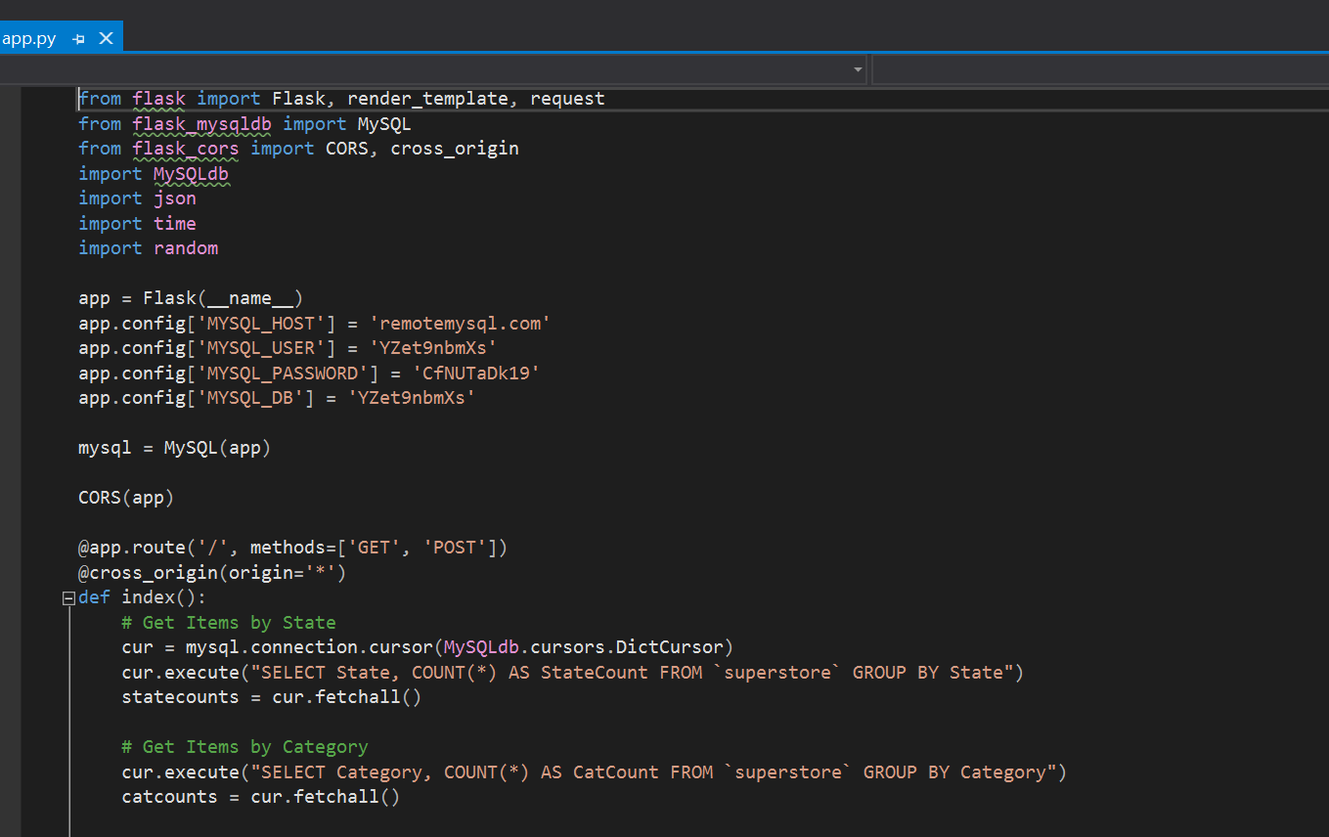
Code

Slide 17
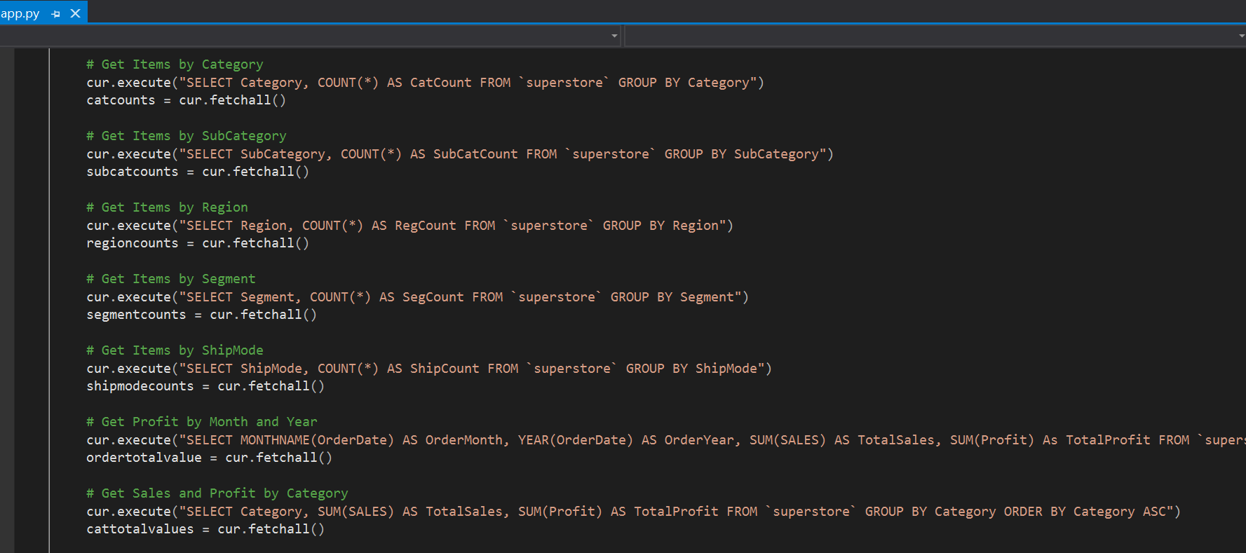

Slide 18
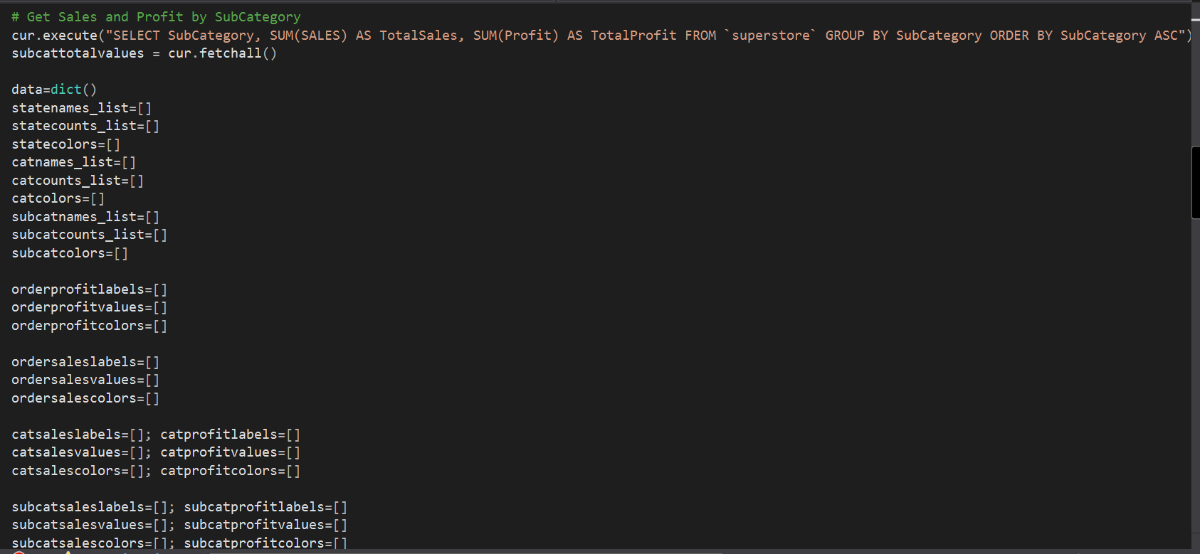

Slide 19
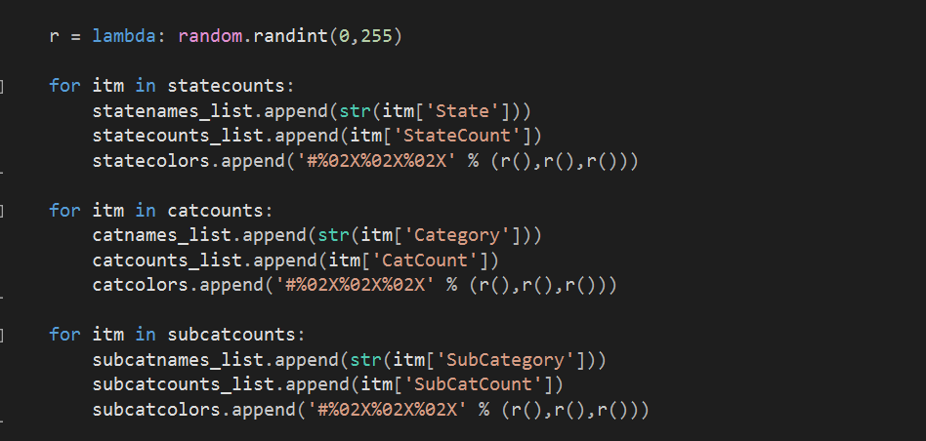

Slide 20
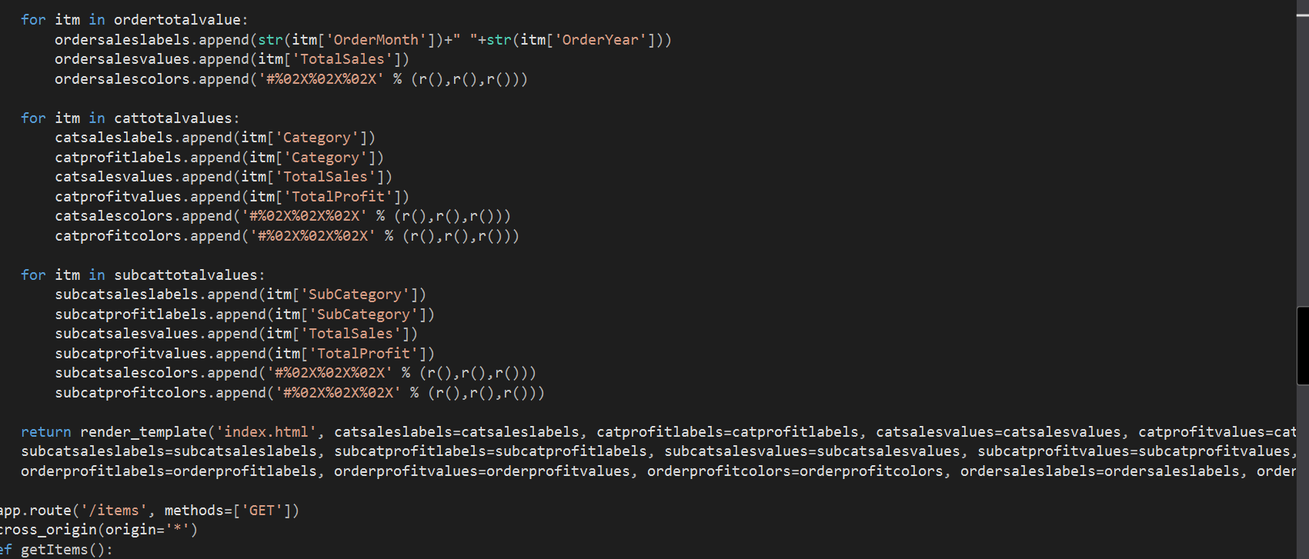

Slide 21
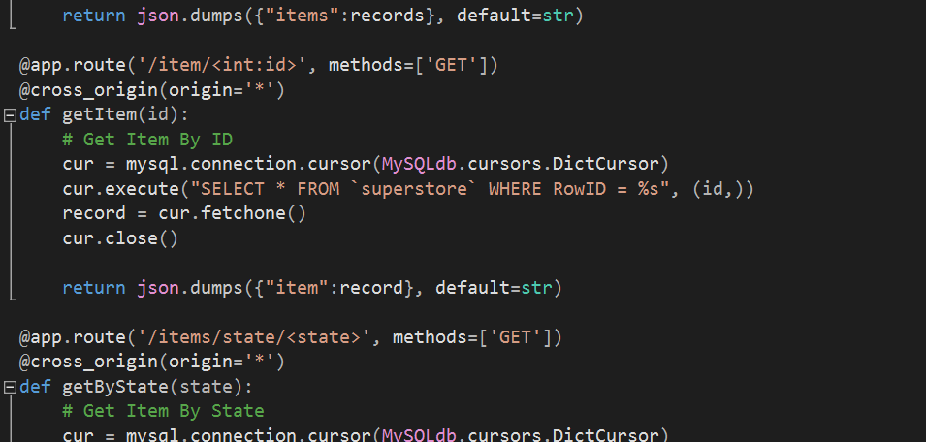

Slide 22
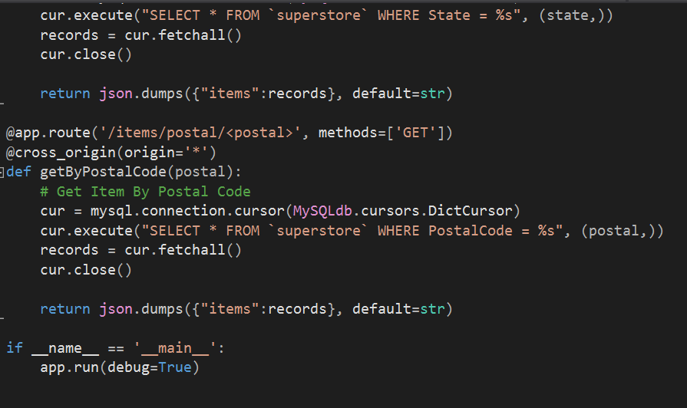

Slide 23

Generating Graph -Map
Create graphics section
Latitude and longitude calculation we made on the data to create a map
Based on Base map library, created the graph
The data is taken from the database which is generated earlier in the code

Slide 24
HERE IS THE LINK TO OUR WEB APPLICATION
https://dataviz99.herokuapp.com/
This web application is accessible by everyone and is clear to understand

Slide 25
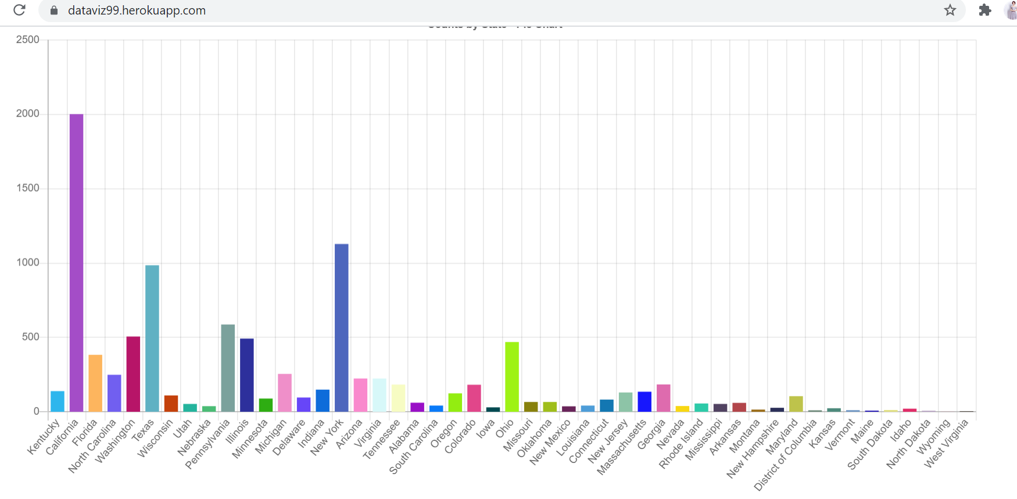

Slide 26
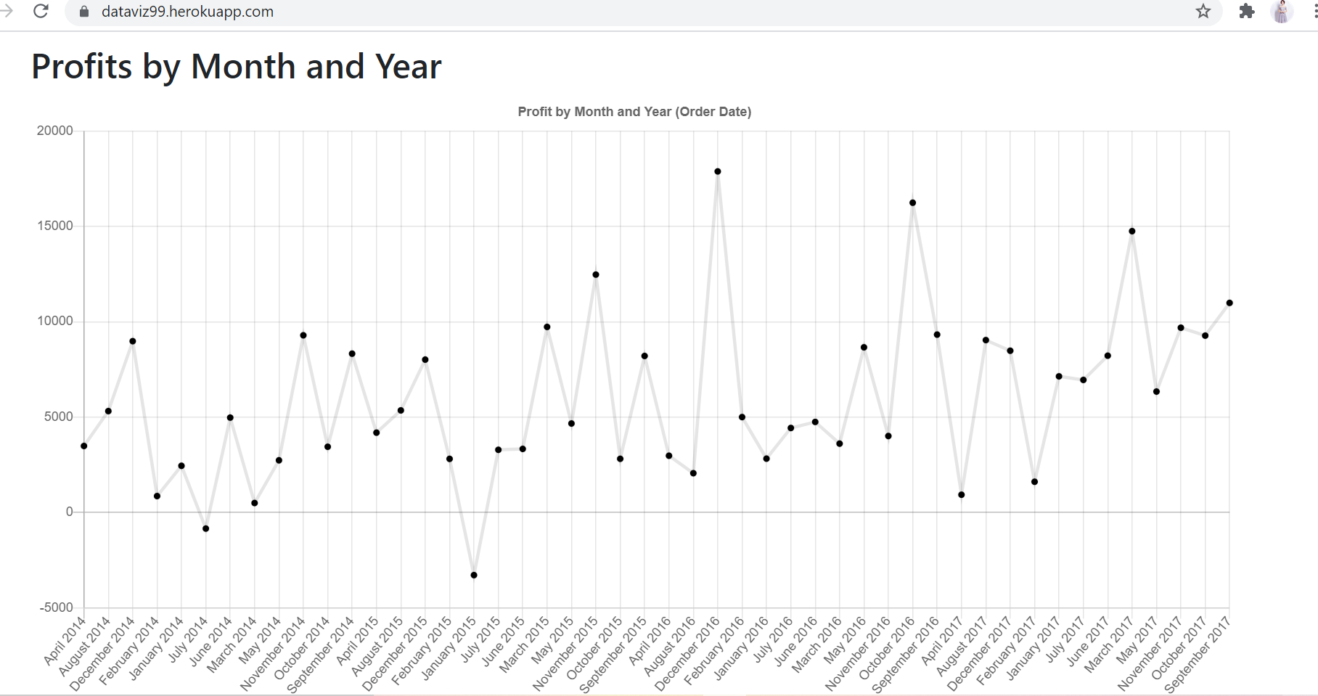

Slide 27
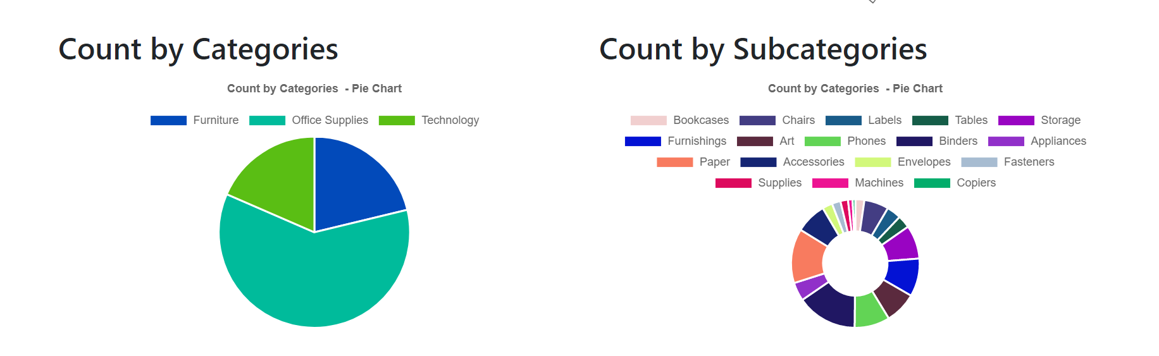
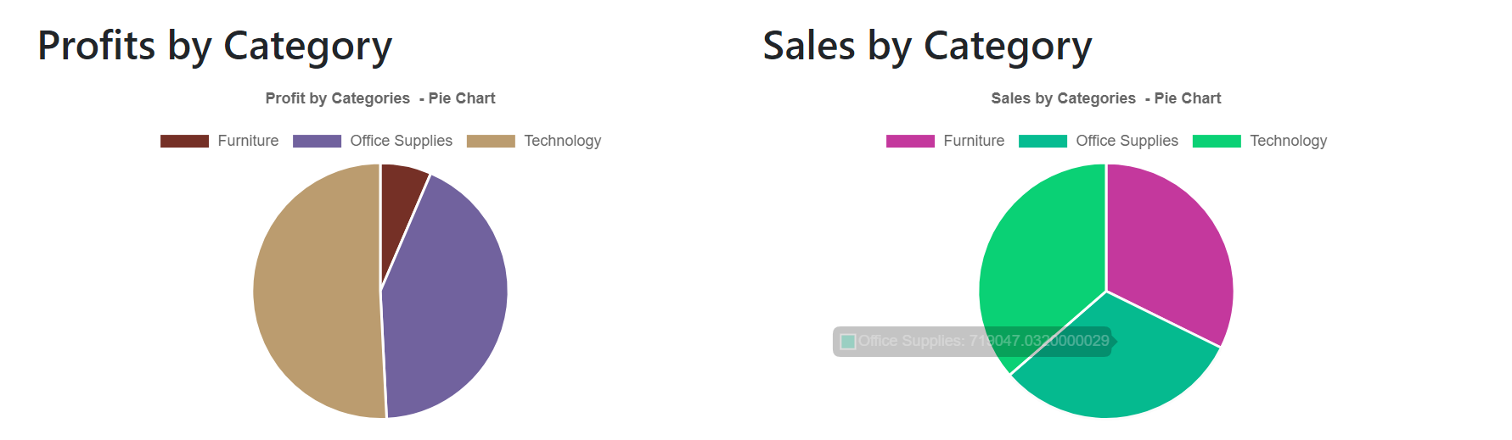

Slide 28
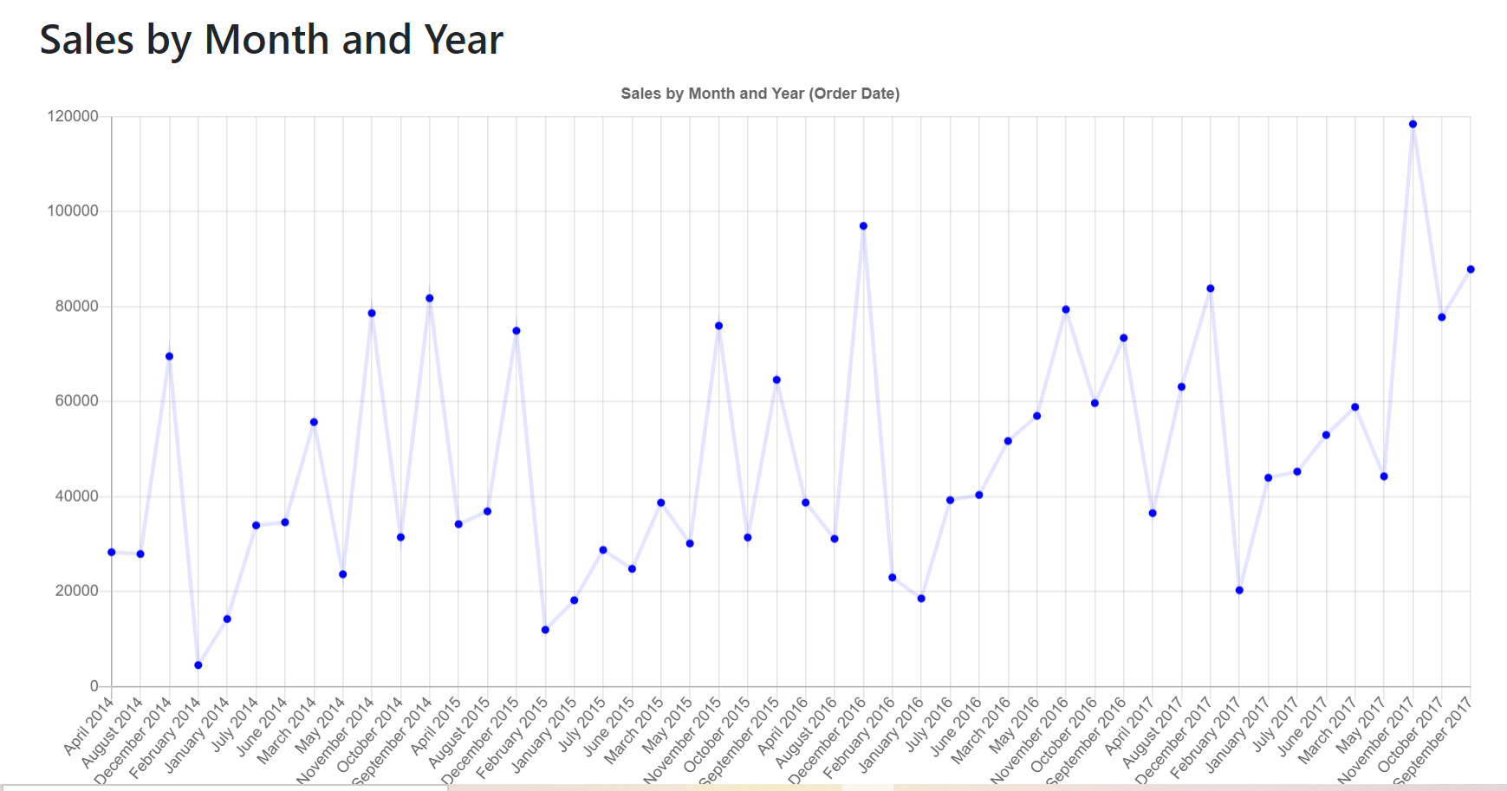

Slide 30
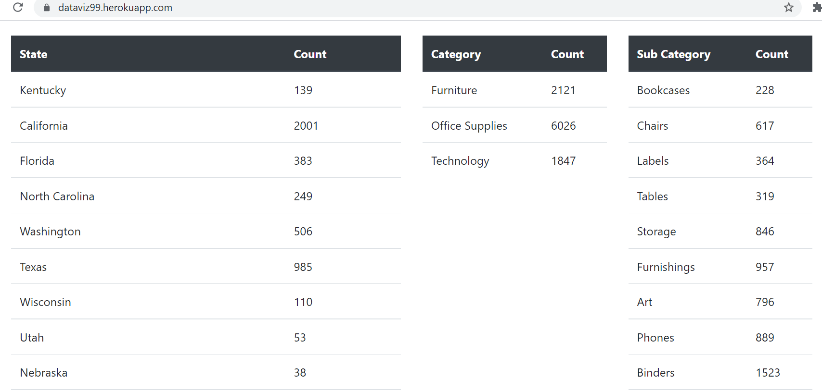

Slide 31
Business value
The Superstore data can lead them to growth of the supermarket for following years and can eliminate the unused product in the store.
Our ability to quickly integrate reliable data into structures like a panda data frame or SQL Database empowers us, and others, to create visuals that will help people understand what is happening around them in a way that nudges them towards smarter choices like increased social distancing

Slide 32
Conclusion
A project full of unexpected roadblocks and challenges.
01
A very simple product at the end, but we can see the path towards a more complex and interactive dashboard.
02
Not something we would have been able to do at the beginning of the course.
03

Slide 33

Thank you

